Slide 1

Predicting Loan Defaults using Predictive Analytics
DAT 690- Data Analytics Capstone
SNHU
By LIKANE ANNE DRUIDE
10/12/2019

Slide 2
Introduction
Background:
Company: GE credit department provides credit and financing solutions.
Current situation: GE is approving credit requests based on the applicants’ socio demographic and financial data.
Challenge: How to limit the credit risk associated with the loans.
Solution : Use Predictive analytics to predict future loan defaults.
Notes:
A loan becomes a problem for the company (financial cost) when clients default or are late on their payments. The predictive analytic structure is in line with GE’s overall risk management strategy. The idea with Predictive analytics is to build a model that will be able to determine good and bad financing/credit customers. That way, appropriate decisions (approval or not) can be made beforehand.

Slide 3
Introduction- Cont’d
Significance of the predictive model in solving the problem:
-Identify the variables that have the most effect on people’s ability to pay back their debts.
-Help define a rigorous approach to how credit/loan is approved.
-Improve risk management.
Notes:
The model will help to find out which circumstances may lead to default payments. With a data analytics plan , GE can make decisions based on data, facts which makes credit approval process more structured, reliable and reproducible.

Slide 4
Logistic Regression- Evaluation
A Predictive model was built using data from 1,000 past customers.
Success: Model can determine which applicant will default with a 78% accuracy level.
Challenge: Identify the most appropriate predictors of credit risks. Data privacy and security
Current practice | With predictive capabilities
Loan/Financing decisions based on financial, socio demographics of applicants. | Loan/Financing decisions based on financial, socio demographics of applicants with known (estimated) risk level.
NA | Prediction of future loan defaults
NA | Model Results are 80.7% accurate
Notes:
The ethical, security and privacy considerations in this case are related to the collection, transmission and proper use of the applicants’ data. Get informed consent prior to data collection. GE should also have strict policies regarding data access, storage.

Slide 5
Model Implementation : Logistic Regression
Analytic tool
R and Rattle. R is free powerful statistical software. Rattle is an easy to use Graphical User Interface (GUI) for the R software.
These tools allow to analyze large datasets to create data visualizations and to build models.
Notes:
When implemented, the model will be used every time a client comes to request some credit to decide if the loan should be granted or not. This will be part of GE risk management strategy that is to serve its clients, stay competitive while limiting its risks.

Slide 6
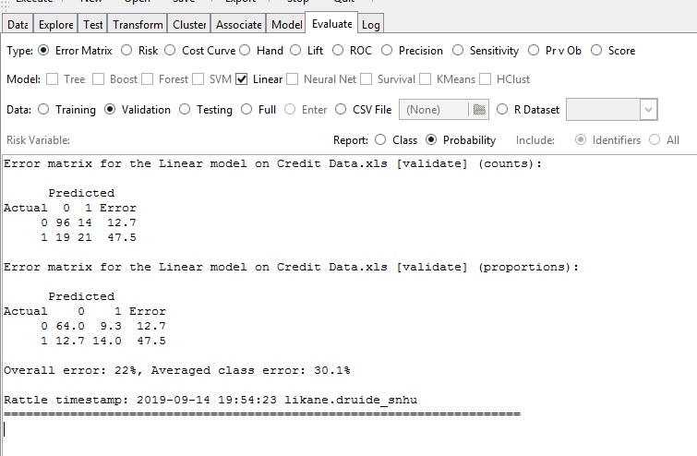
Logistic Regression Model Results
Confusion Matrix
Model can predict that an applicant will default on his payment with a 78% accuracy.

Slide 7
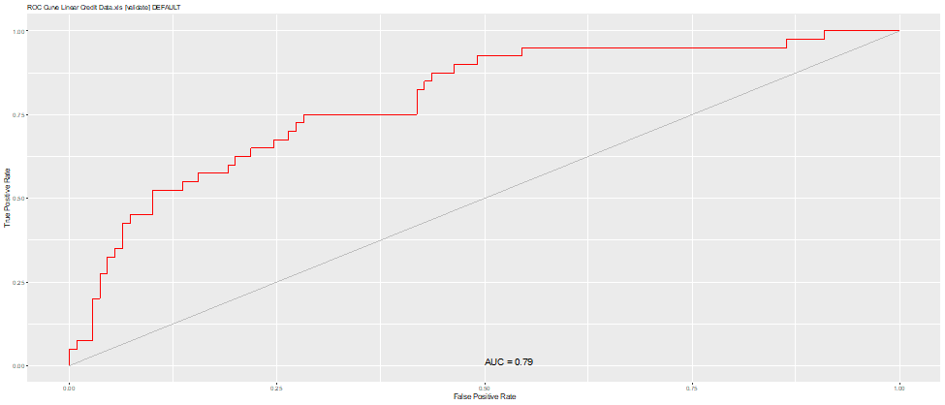
Logistic Regression Model Results
ROC
The area under the ROC curve is 0.7920 which is good (good predictive ability)
Notes:
it indicates that the model can differentiate between a good and a bad credit applicant.

Slide 8
Model’s goodness of fit
-Pseudo R2 = 0.5369: the model can account for 53.7% data variability.
- Null deviance: 855.21 on 699 degrees of freedom.
-Residual deviance: 636.27 on 669 degrees of freedom.
- Residual deviance < null deviance: the model is a good fit to the data.
Notes:
R² value is a measure of how close our data are to the linear regression model. R² values are always between 0 and 1; numbers closer to 1 represent well-fitting models.

Slide 9
Conclusions
- The predictive model can help GE accurately identity customers likely to default on loan payments in 78% of the time.
- The implementation of the model will help GE stay competitive while limiting its risks.
- The cost of the project is relatively low compared to the benefits.

